Slide 1


Ministry of Communications and Information Technology
Information Technology Institute
Information Technology Institute
Haitham A. El-Ghareeb, Ph.D.
Associate Professor
Information Systems Department
Faculty of Computers and Information Sciences
Mansoura University
http://www.helghareeb.me
2012

Slide 2
Ministry of Communications and Information Technology
Information Technology Institute
Information Technology Institute
Network Fundamentals
Lecture 2
OSI and TCP/IP Model

Slide 3
Objectives
By the end of this chapter, you will be able to:
  Differentiate between the seven layers in OSI model
  Define the importance of OSI model
  Name and order the seven layers in OSI model
  Illustrate how the data find its way through the network from the sender to the receiver

Slide 4
OSI Reference Model
OSI: Open Systems Interconnection
The OSI model is the primary architectural model for networks.
It describes how data and network information are communicated from an application on one computer, through the network media, to an application on another computer.
The model was defined by the International Organization for Standardization (ISO)
The OSI reference model breaks this approach into layers.

Slide 5
Advantages of Reference Models
It divides the network communication process into smaller and simpler components, thus aiding component development, design, and troubleshooting.
It allows multiple-vendor development through standardization of network components.
It encourages industry standardization by defining what functions occur at each layer of the model.
It allows various types of network hardware and software to communicate.
It prevents changes in one layer from affecting other layers, so it does not hamper development.

Slide 6
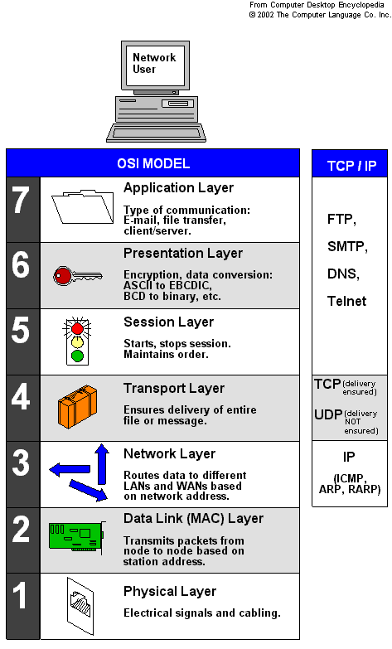
OSI Seven Layers
Application
Presentation
Session
Transport
Network
Data Link
Physical

Slide 7
Application Layer
Provides a mean for the user to access information on the network through an application
This layer is the main interface for the user(s) to interact with the application and therefore the network
Displays received information and sends data to lower layers.

Slide 8

Application Layer
What should I send?
End-user Interface
Where client applications reside
Displays received information
Sends user’s data to lower layers
Notes:
Application Layer
provides a means for the user to access information on the network through an application.
This layer is the main interface for the user(s) to interact with the application and therefore the network.

Slide 9
Presentation Layer
The presentation layer is responsible for the delivery and formatting of information to the application layer for further processing or display.
It relieves the application layer of concern regarding syntactical differences in data representation within the end-user systems.
An example of a presentation service would be the conversion of an EBCDIC-coded text file to an ASCII-coded file.
Notes:
EBCDIC: Extended Binary Coded Decimal Interchange Code
ASCII: American Standard Code for Information Interchange

Slide 10


Session Layer
Controls the sessions between the local and remote applications
I would like to
send you
something.
Sounds
good!
Thank you.
You are
welcome!
Establish
Connection
Close
Connection
Notes:
The Session layer controls the sessions between computers.
It establishes, manages and terminates the connections between the local and remote application.

Slide 11
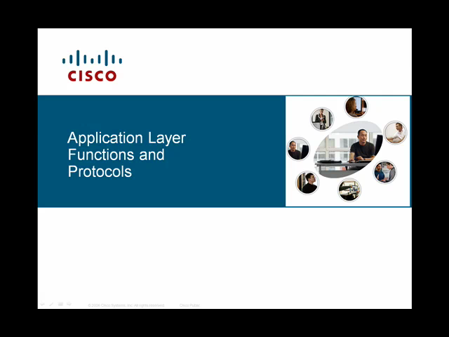

Slide 12
Transport Layer
Till now, there is Session opening between the Sender and the Receiver
But if the receiver is Opening more than one application, How the Sender direct the data to the right application?
There is services that can be optionally provided at this layer:
  Connection-Oriented
  Reliable Data
Notes:
Organize data into segments
Provide transparent transfer of data between hosts.
It is usually responsible for end-to-end error recovery and flow control, and ensuring complete data transfer.

Slide 13
Transport Layer Services
Organize data into segments
Provide transparent transfer of data between hosts
It is usually responsible for end-to-end error recovery and flow control, and ensuring complete data transfer
Port #

Slide 14
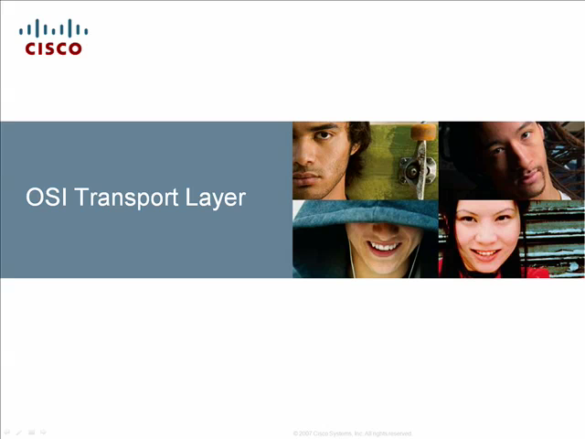

Slide 15
Network Layer
Data in Network Layer is converted into a Packet, which is: Segment + Header
Network Layer has a Logical Address (IP Address)
Header carries Source IP Address, and Destination IP Address
Routing
  Provides the functional and procedural means of transferring variable length data sequences from a source to a destination via one or more networks

Slide 16
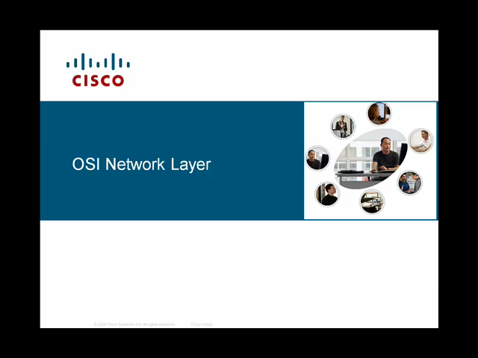

Slide 17
Data Link Layer
Responsible for organizing data into Frames, by adding Header.
Header holds Source Mac Address and Destination Mac Address
Trailer holds the result of CRC: Cyclic Redundancy Check
Reliable data transfer across a physical link
  It provides the means to detect errors that may occur in the Physical layer.

Slide 18
MAC Address
Media Access Control Address
Unique Identifier assigned to network interfaces for communications on the physical network
Managed by Institute of Electrical and Electronics Engineers (IEEE)
48 bits:
  24 bits for the Vendor
  24 bits for the Serial No.

Slide 19
Switches and MAC Addresses
Switches has MAC Address Table
Empty MAC Address Table at the beginning
Illustrate Switch MAC Learning Process

Slide 20


Slide 21
Physical Layer
The Physical layer defines all the electrical and physical specifications for devices.
The physical layer is the most basic network layer, providing only the means of transmitting raw bits.
No Protocols.
Notes:
Transmission of unstructured bit stream over the physical link

Slide 22
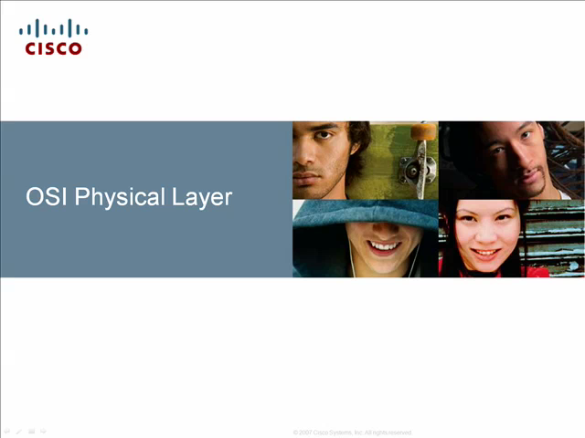

Slide 23
Summary
In this chapter, we explained:
  OSI Model
  Application Layer
  Presentation Layer
  Session Layer
  Transport Layer
  Network Layer
  Data Link Layer
  Physical Layer

Slide 24
Quiz
…. Layer establishes, manages, and terminates the connections between the local and remote devices.
  Application
  Presentation
  Session
  Transport

Slide 25
Quiz
….. Is the shape of data in transport layer.
  Frame
  Packet
  Segment
  Bit

Slide 26
Quiz
….. Is a protocol that used in video streaming.
  TCP
  UTP
  CSMA/CD
  OSI

Slide 27
Quiz
….. Layer is responsible for organizing the data into frames.
  Application
  Presentation
  Data link
  Transport

Slide 28
Quiz
The IP version 4 consists of…..
  128 bits
  32 bits
  2 bits
  255 bits

Slide 29
TCP / IP Model
Chapter Three

Slide 30
Objectives
TCP/IP Protocol Suite
Application Layer
Transport Layer
  TCP
  UDP
Network Layer

Slide 31
Why TCP/IP?
Standard
Routable
Cross Platform
Dominant commercial protocol architecture
Specified and extensively used before OSI
Developed by research funded US Department of Defense
Used by the Internet

Slide 32
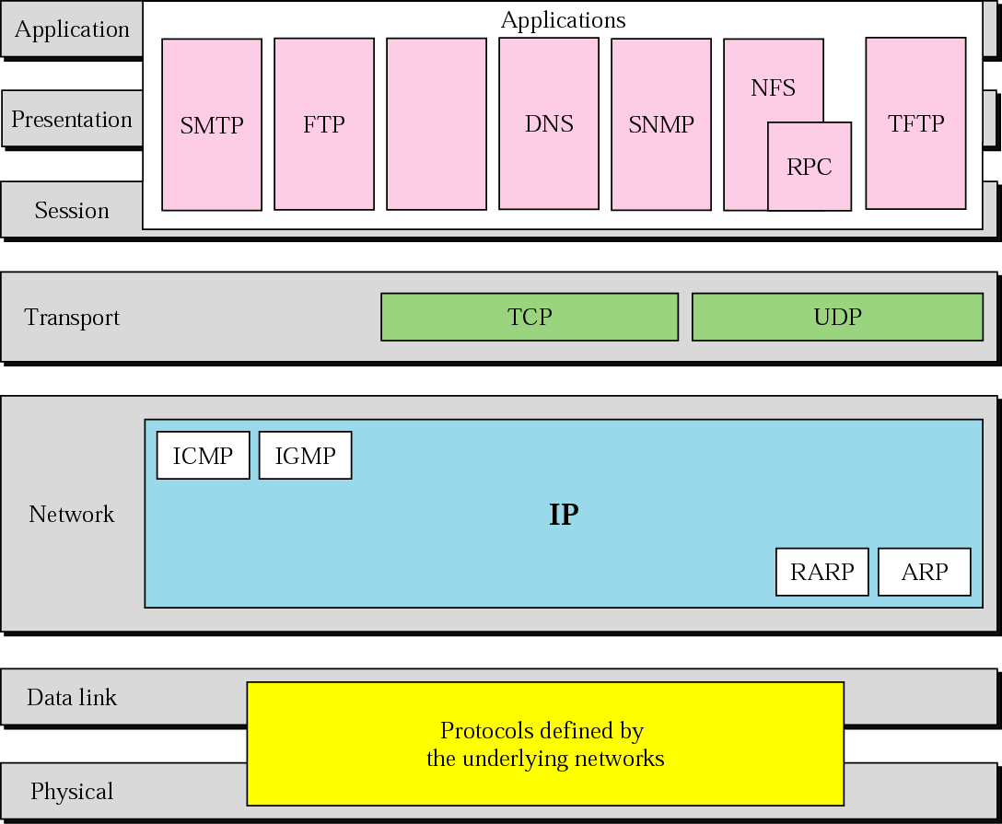
TCP/IP Protocol Suite

Slide 33
TCP/IP Protocol Architecture
Application Layer
  Communication between processes or applications
Transport Layer (TCP/UDP)
  End to end transfer of data
  May include reliability mechanism (TCP)
  Hides detail of underlying network
Internet Layer (IP)
  Routing of data

Slide 34
TCP/IP Protocol Architecture (cont.)
Network Layer
  Logical interface between end system and network
Physical Layer
  Transmission medium
  Signal rate and encoding

Slide 35
TCP/IP Acronyms
Protocol Data Unit (PDU)
Encapsulation
Decapsulation
Segmentation

Slide 36
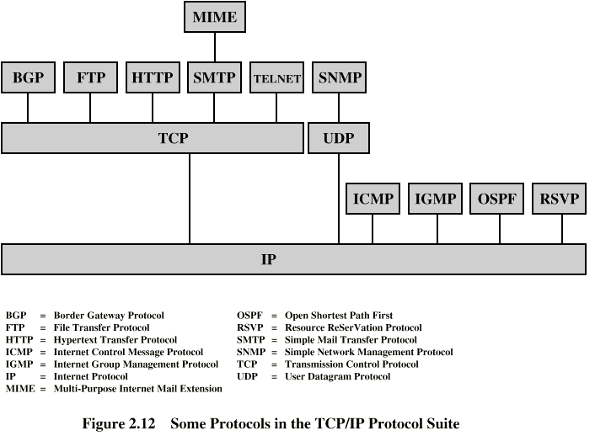
TCP/IP Protocols

Slide 37
UDP
User Datagram Protocol
Transport layer protocol
Process to process communication
  Use port numbers
Connectionless
Unreliable
Perform very limited error checking
Very simple using a minimum of overhead

Slide 38
TCP
Transmission Control Protocol
Transport layer protocol
Process to process communication
Use port numbers
Reliable ( Use acknowledgements )
Connection oriented (Three way handshake)
Flow control (window size)

Slide 39
Port numbers
Well Known ports
  Range from 0 to 1,023
Registered ports
  Range from 1,024 to 49,151 not assigned or controlled by ICANN but can be registered at ICANN to avoid duplication
Dynamic ports
  Range from 49,152 to 65,535 are neither controlled nor registered

Slide 40
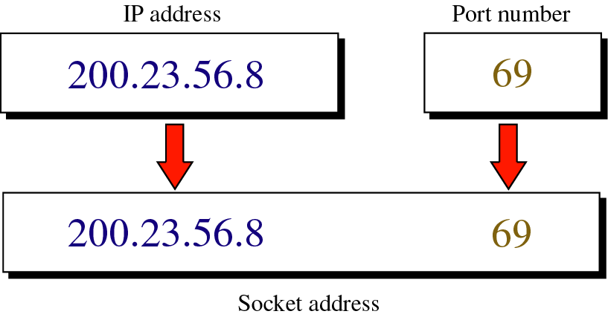
Socket Address

Slide 41
Warriors of the Net
The Movie

Slide 42
Some Acronyms
Proxy
Packet
Router
Switch
Router Switch
Firewall

Slide 43
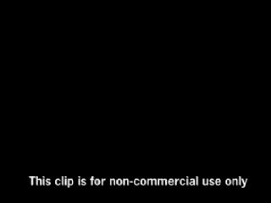

Slide 44
Discussion
Questions

Slide 45
Thank you

